Slide 1

Fighting for Weighted Student Funding in 2017
PowerPoint presentation courtesy of Educate Nevada Now,
Powered by the Rogers Foundation
Saving PUBLIC EDUCATION:

Slide 2
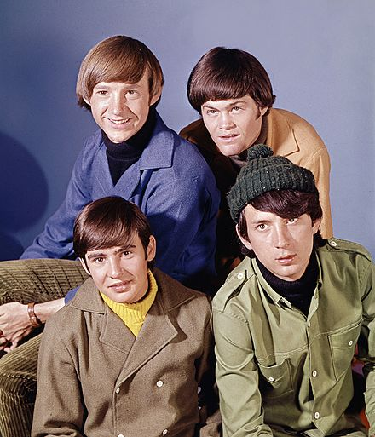

Weighted Funding
The Task Force on Public Education, born from the 2013 Legislative Session, was created to examine how to improve public education through modernizing NV’s 50-year-old funding formula...
The Graduate
I’m A Believer,
The Monkees

Slide 3
Task Force Recommendations
The bi-partisan Task Force elicited input from the community and experts, and examined cost studies, and concluded:
To provide additional funding to English Language Leaners (ELL), Special Education, and At-Risk (low income) weight, or multiplier
  2.0 Special Ed; 1.5 ELL/At-Risk
These students needed additional resources to meet their full potential, and this is consistent with other states’ more modern formulas

Slide 4
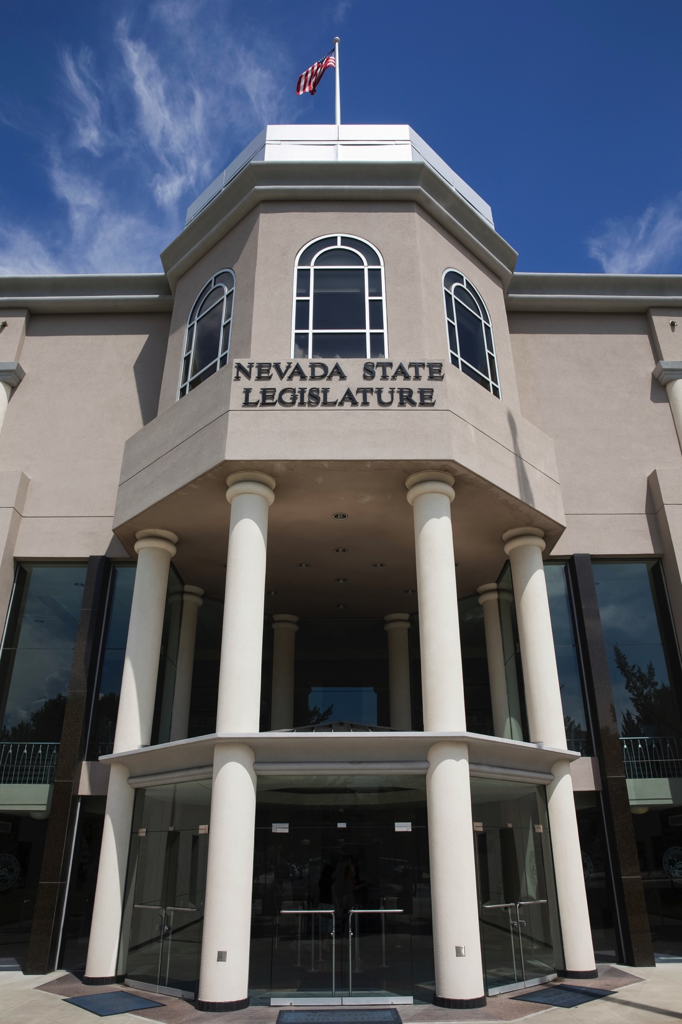
SB 508, 2015 NV Legislature
SB 508 agreed the formula needed to be updated; asked the State Superintendent to develop weights to “meet the unique needs” of these students
But instead, the Superintendent simply expressed the old NV Plan inadequate funding as fake weights
There is little additional funding – only $30 million for special ed-- ignoring the Task Force and the unique needs of these students.

Slide 5

Winners and Losers
The proposed “weights”
continue a game of
winners and losers
Districts have to divert 10-15% of their general education budget to fund Special education;
All students lose, rurals and Washoe suffer the most.

Slide 6
Winners and Losers
  Zoom and Victory school
  categorical funding, for high ELL
  and FRL schools cover only a
  portion of the need.
  ONE out of TWO ELL kids “WIN”; and ONLY ONE out of TEN working/poor family kids get extra help.
  Superintendent claims that categoricals are “weighted funding” but this fails the definition.
  The Superintendent's proposed weights are inadequate; more funding is needed and we need to expand the pie!

Slide 7
WHAT DO SPECIAL EDUCATION
PARENTS NEED From THIS BUDGET?
Special Education costs lead to a statewide
$350 million BUDGET DEFICIT
The GOVERNOR, based on Superintendent’s SB508 recommendation, increased Special Education budget by only $30 million.
EVERY school district is SQUEEZED, having to take an average 13% of GENERAL BUDGET to pay for the legally mandated MINIMAL services special ed kids are entitled to!

Slide 8
WHAT DO GATE PARENTS NEED From THIS BUDGET?
SB 508 requires GATE funding.
The GOVERNOR, based on Superintendent’s SB508 recommendation, has set aside $5 million for all of Nevada’s GATE kids.
School district, because they are SQUEEZED, have MINIMAL programs for GATE kids.

Slide 9
WHAT DO POOR and WORKING PARENTS NEED From THIS BUDGET?
Victory funding of $40 million for 35 schools covers 22,000 kids.
Nevada has 230,000 kids with low family income (FRL)
K-12 Task Force recommended 1.5 weight; Superintendent recommends 1.2 weight.

Slide 10
WHAT DO ELL PARENTS NEED From THIS BUDGET?
ELL kids are the worst performing special group; only 1 in 5 read at level in K-5
Zoom funding has been significant growth catalyst for 70 elementary schools in the state. Another 200 need program support.
But, rurals have not gotten much zoom $
K-12 Task Force recommended 1.5 weight (for 78,000 kids); Superintendent recommends 1.2 weight (for 44,000 kids).

Slide 11
Join us in the fight for public education!
Money matters in education – quality teachers, classroom supplies, safe and comfortable facilities, good professional development...all matter.
EQUITY improves education for all kids!
Parents should not be fighting other parents for resources their kids need.

Slide 12
Visit ENN’s website join our mailing list.
Please check out
educatenevadanow.com
for updates, information, and advocacy tools.

